Slide 1
ETHICAL HACKING INTERNSHIP

Slide 2
Task 1:
Screenshot of solved Portswigger labs.

Slide 3
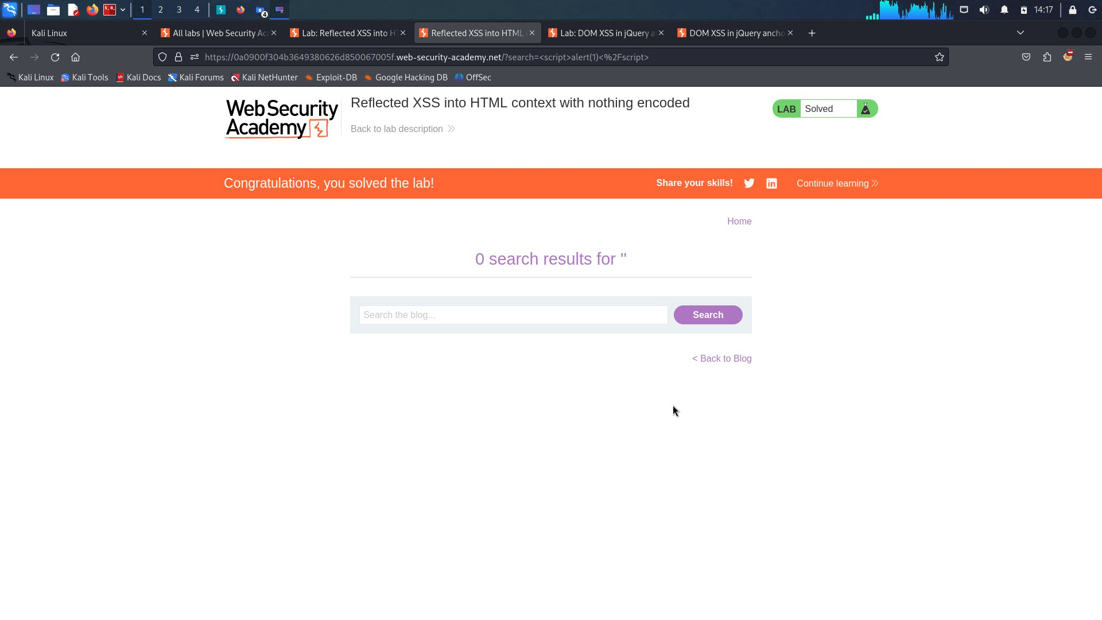

Slide 4
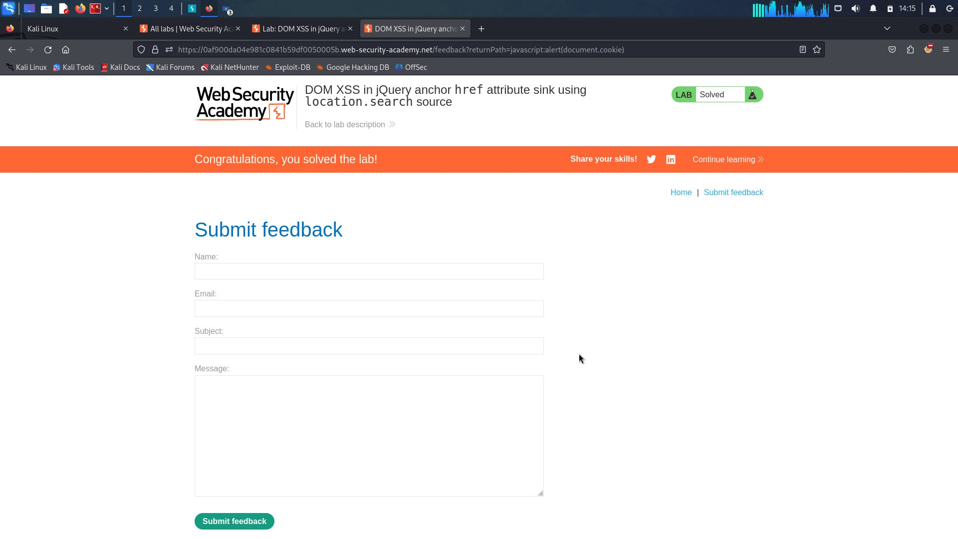

Slide 5
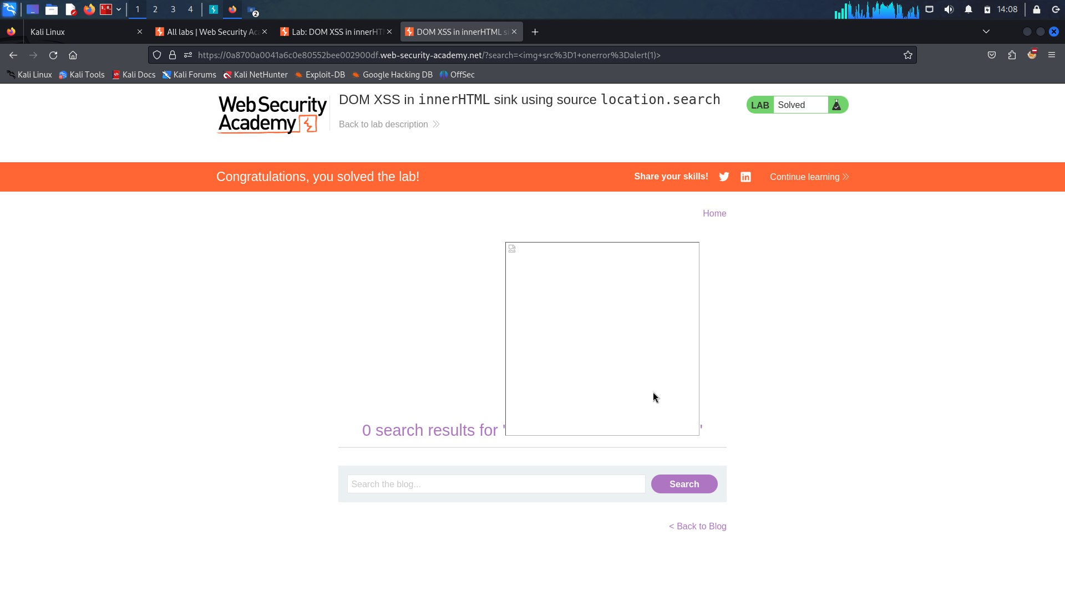

Slide 6
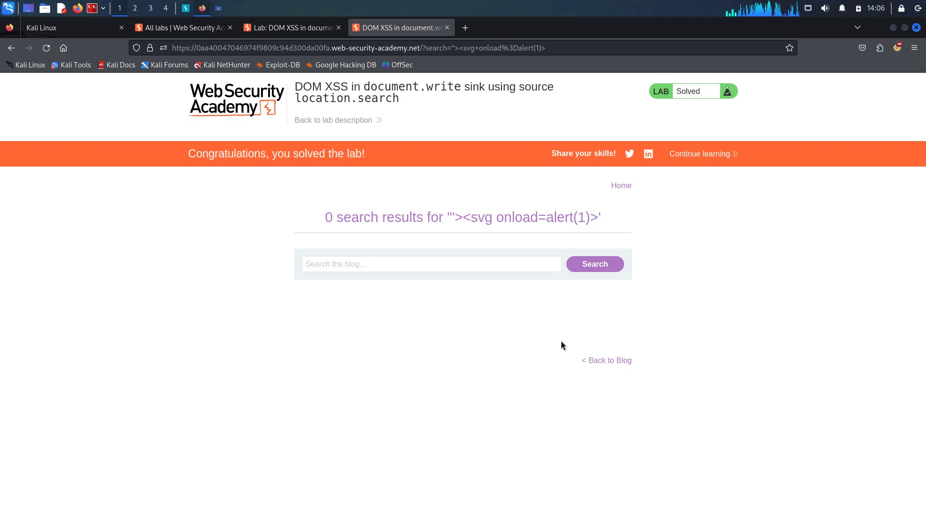

Slide 7
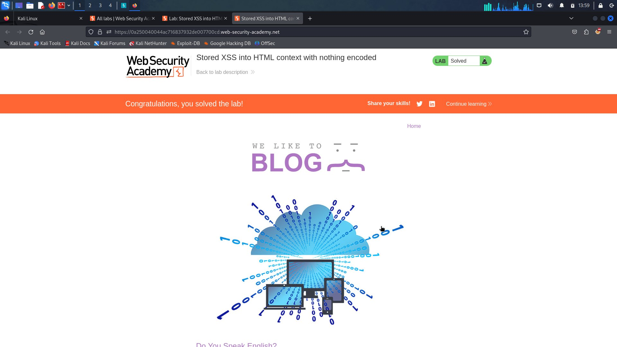

Slide 8
Thank you

